Slide 1
IT2070 – Data Structures and Algorithms
Lecture 07
Introduction to Divider and Conquer Method
U. U. Samantha Rajapaksha
M.Sc.in IT, B.Sc.(Engineering) University of Moratuwa
Senior Lecturer SLIIT
Samantha.r@slit.lk

Slide 2
Today's Lecture
Divide and Conquer
Applications
- Quick Sort
- Merge Sort
Analysis

Slide 3
Divide and Conquer
Divide: Break the problem into sub problem recursively.
Conquer: Solve each sub problems.
Combine: All the solutions of sub problems are combined to get the solution of the original problem.

Slide 4
Applications
Quick Sort
- More work on divide phase.
- Less work for others.
Merge Sort
- Vice versa of Quick sort.

Slide 5
Quick Sort (contd.)
Divide:
Partition (rearrange) the array A[p..r] into two (possibly empty) sub arrays A[p..q - 1] and A[q + 1..r]
Each element of A[p..q - 1] is less than or equal to A[q]
Each element of A[q + 1..r]is greater than or equal to A[q].
Compute the index q as part of this partitioning procedure.
Conquer:
Sort the two subarrays A[p..q -1] and A[q +1..r] by recursive calls to quicksort.
Combine:
Since the sub arrays are sorted in place, no work is needed to combine them: the entire array A[p..r] is now sorted.

Slide 6
Quick Sort procedure
Input: Unsorted Array (A,p,r)
Output: Sorted sub array A(1..r)
QUICKSORT (A,p,r)
1 if p < r
2 q = PARTITION(A, p, r)
3 QUICKSORT (A, p, q-1)
4 QUICKSORT (A, q+1, r)
To sort an entire array A, the initial call is
QUICKSORT(A, 1, A.length).

Slide 7
Partition Algorithm
PARTITION(A, p, r)
1 x = A[r]
2 i = p - 1
3 for j = p to r - 1
4 if A[j] ≤ x
5 i = i + 1
6 exchange A[i] with A[j]
7 exchange A[i + 1] with A[r]
8 return i + 1
The key to the algorithm is the PARTITION procedure, which rearranges the sub array A [p..r] in place.

Slide 8
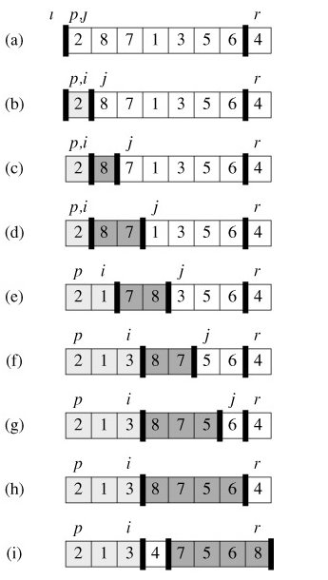
Operation of PARTITION on an 8-element array.
Element x = A[r] is the pivot element
The initial array
The value 2 is "swapped with itself" and put in the partition of smaller values.
(c)-(d) The values 8 and 7 are added to the partition of larger values.
(e) The values 1 and 8 are swapped, and the smaller partition Grows.
(f) The values 3 and 7 are swapped, and the smaller partition grows.
(g)-(h) The larger partition grows to include 5 and 6 and the loop terminates.
(i) Pivot element is swapped so that it lies between the two partitions.

Slide 9
Operation of PARTITION on an 8-element array.
first partition with values <= pivot
second partition with values > pivot
white element - pivot.

Slide 10
Analysis of Quick sort
The running time of quick sort depends on the partitioning of the sub arrays:
(a) Worst case partitioning (Unbalanced partitioning)
Worst case occurs when the sub arrays are completely unbalanced. i.e. 0 elements in one sub array and n − 1 elements in the other sub array
n
1
n-1
1
n-2
1
n-3
1
n-4

Slide 11
Analysis of Quick sort
Worst case partitioning (Repeated Substituted method)
Partitioning → Θ(n)
Recursive call on an array of size 0 → T(0) = Θ(1)
Recursive call on an array of size (n-1) → T(n-1)
Therefore Recurrence Equation is
T(n) = T(n-1) +T(0)+ Θ(n)
= T(n-1) + Θ(n)
= T(n-2) + Θ(n - 1) + Θ(n)
………………….
= T(0) + Θ(1) + Θ(2) + …. + Θ(n - 1) +Θ(n)
n n
= ∑ (Θ(k)) = Θ ∑ k = Θ(n²)
k = 1 k = 1
Worst case Running Time is Θ(n²)

Slide 12
Analysis of Quick sort
(b) Best case partitioning
Best case occurs when PARTITION produces two sub arrays , one is of size (n-1)/2 and the other is of size (n-1)/2. In this case, quicksort runs much faster.
Recurrence equation is
T(n) = 2T(n/2) + Θ(n)

Slide 13
Analysis of Quick Sort (with recursion tree)
Best Case:
No.of Comparisons
n
n
n/2
n/2
2.n/2 = n
n/4
n/4
n/4
n/4
4.n/4 =n
n/8
n/8
n/8
n/8
n/8
n/8
n/8
n/8
8.n/8 = n
n
1 1 1 1 1 1 1 1 1 1 1 1 1 1 1 1
Best case Running Time is Θ(n lg n)
Θ(n lg n)

Slide 14
Merge sort
Merge Sort is a sorting algorithm based on divide and conquer.
Its worst-case running time has a lower order of growth than insertion sort.
The merge sort algorithm closely follows the divide-and-conquer paradigm. Intuitively, it operates as follows.
Divide: Divide the n-element sequence to be sorted into two subsequences of n/2 elements each.
Conquer: Sort the two subsequences recursively using merge sort.
Combine: Merge the two sorted subsequences to produce the sorted answer.

Slide 15
Merge sort
Divide by splitting into two subarrays A[p . . q] and A[q + 1 . . r], where q is the halfway point of A[p . . r].
Conquer by recursively sorting the two subarrays A[p . . q] and A[q + 1 . . r].
Combine by merging the two sorted subarrays A[p . . q] and A[q + 1 . . r] to produce a single sorted subarray A[p . . r].
To accomplish this step, we’ll define a procedure MERGE(A, p, q, r).

Slide 16
Merge sort procedure
Input : A an array in the range 1 to n.
Output : Sorted array A.
MERGESORT (A, p, r)
1. if p < r
2. q = ⎣(p+r )/2⎦
3. MERGESORT (A, p, q)
4. MERGESORT (A, q+1, r)
5. MERGE (A, p, q, r)

Slide 17
Merge procedure
MERGE(A, p, q, r)
1 n₁ = q - p + 1
2 n₂ = r - q
3 create arrays L[1.. n₁ + 1] and R[1.. n₂ + 1]
4 for i = 1 to n₁
5 L[i] = A[p + i - 1]
6 for j = 1 to n₂
7 R[j] = A[q + j]
8 L[n₁ + 1] = ∞
9 R[n₂ + 1] = ∞
10 i = 1
11 j = 1
12 for k = p to r
13 if L[i] ≤ R[j]
14 A[k] = L[i]
15 i = i + 1
16 else A[k] = R[j]
17 j = j + 1

Slide 18
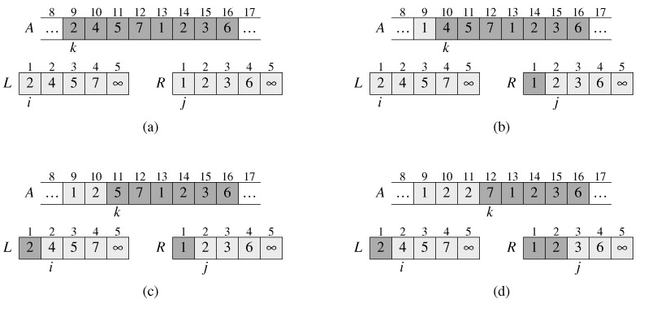
Illustration when the subarray A[9..16] contains the sequence 〈2, 4, 5, 7, 1, 2, 3, 6〉

Slide 19
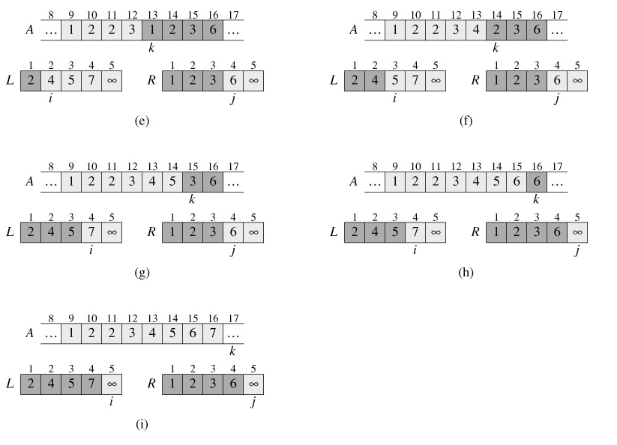

Slide 20
Analysis of Merge Sort
To find the middle of the sub array will take Θ(1).
To recursively solve each sub problem will take 2T(n/2).
To combine sub arrays will take Θ(n).
Therefore T(n)=2T(n/2)+ Θ(n) + Θ(1)
We can ignore Θ(1) term.
T(n)=2T(n/2)+ Θ(n)

Slide 21
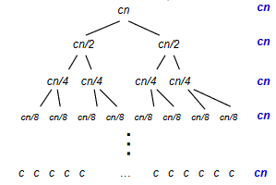
Analysis of Merge Sort
T(n) = 2T(n/2) + cn
2T(n/2) = 4T(n/4) + 2cn/2
4T(n/4) = 8T(n/8) + 4cn/4 - -
-
- T(2) = nT(1) + (n/2) c*2 ----------------------------- ----------------- add and cancel:
T(n) = nT(1) +cn+cn+...+cn
= nT(1) + cn * log₂ n = Θ(nlog n)

Slide 22
Summary.
Divide and conquer method.
Quicksort algorithm.
Quicksort analysis.
Mergesort algorithm.
Mergesort analysis.

